Slide 1
The Entity-Relationship Model
Lecturer: Ngo Huy Bien
Software Engineering Department
Faculty of Information Technology
VNUHCM - University of Science
Ho Chi Minh City, Vietnam
nhbien@fit.hcmus.edu.vn

Slide 2

Objectives
To create a entity-relationship model
To map classes to tables

Slide 3

Contents

Slide 4

References
Peter Pin-Shan Chen (1976). The Entity-Relationship Model - Toward a Unified View of Data.
Roger S. Pressman (2001). Software Engineering: A Practitioner’s Approach. 5th Edition.
Peter Pin-Shan Chen (1997). English, Chinese and ER Diagrams.
Craig Larman (2004). Applying UML And Patterns.
Grady Booch et al. (2005). Unified Modeling Language User Guide.
Wolfgang Keller (1997). Mapping Objects to Tables: A Pattern Language.
Prakash M. Nadkarni, MD, Cynthia Brandt, MD, MOH (1998). Data Extraction and Ad Hoc Query of an Entity-Attribute-Value Database.

Slide 5
What is Entity-Relationship Model? [1]
A data model, called the entity-relationship model, incorporates some of the important semantic information about the real world.
The entity-relationship model can be used as a basis for unification of different views of data: the network model, the relational model, and the entity set model.

Slide 6
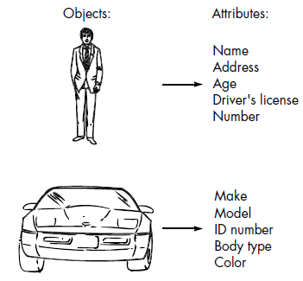
Entity
An entity is a “thing” which can be distinctly identified.
A specific person, company, or event is an example of an entity.

Slide 7
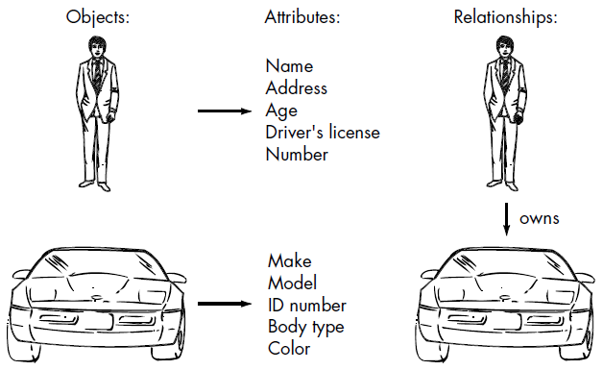
Relationship
A relationship is an association among entities. For instance, “father-son” is a relationship between two “person” entities.’

Slide 8
Entity Set
Let e denote an entity which exists in our minds.
Entities are classified into different entity sets such as EMPLOYEE, PROJECT, and DEPARTMENT.
There is a predicate associated with each entity set to test whether an entity belongs to it.
For example, if we know an entity is in the entity set EMPLOYEE, then we know that it has the properties common to the other entities in the entity set EMPLOYEE. Among these properties is the aforementioned test predicate.

Slide 9
Relationship Set & Role
A relationship set, R_{i}, is a mathematical relation among n entities, each taken from an entity set:
{[e₁, e₂, . . . , e_{n}] | e₁ ∈ E₁, e₂ ∈ E₂, . . . , e_{n} ∈ E_{n}},
and each tuple of entities, [e₁, e₂, . . . , e_{n}], is a relationship.
The role of an entity in a relationship is the function that it performs in the relationship. “Husband” and “wife” are roles.
The ordering of entities in the definition of relationship (note that square brackets were used) can be dropped if roles of entities in the relationship are explicitly stated as follows: (r₁/e₁, r₂/e₂, . . . , r_{n}/e_{n}) , where r_{i} is the role of e_{i} in the relationship.

Slide 10

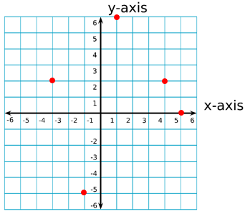
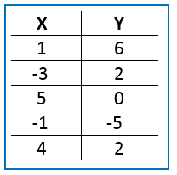
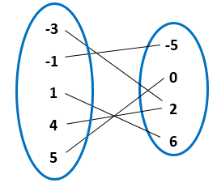
Mathematical Relation
A relation is a relationship between sets of values.
In math, the relation is between the x-values and y-values of ordered pairs. The set of all x-values is called the domain, and the set of all y-values is called the range.
Relations can be displayed as a table, a mapping or a graph.
Notes:
https://study.com/academy/lesson/relation-in-math-definition-examples.html

Slide 11
Values and Values Set
The information about an entity or a relationship is obtained by observation or measurement, and is expressed by a set of attribute-value pairs.
“3”, “red”, “Peter”, and “Johnson” are values.
Values are classified into different value sets, such as FEET, COLOR, FIRST-NAME, and LAST-NAME.
There is a predicate associated with each value set to test whether a value belongs to it.

Slide 12
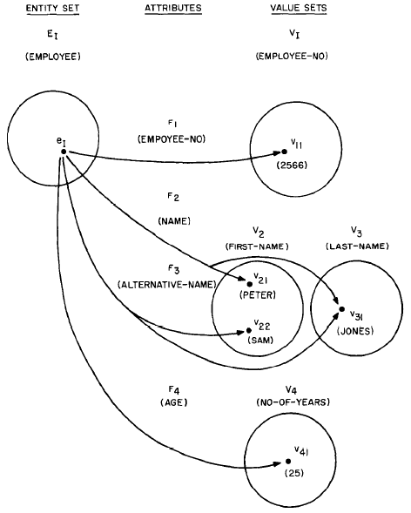
Attribute
An attribute can be formally defined as a function which maps from an entity set or a relationship set into a value set or a Cartesian product of value sets:
f: E_{i} or R_{i} ⟶ V_{i} or
V_{i1} ✕ V_{i2} ✕ ∙ ∙ ∙ ✕ V_{in}

Slide 13
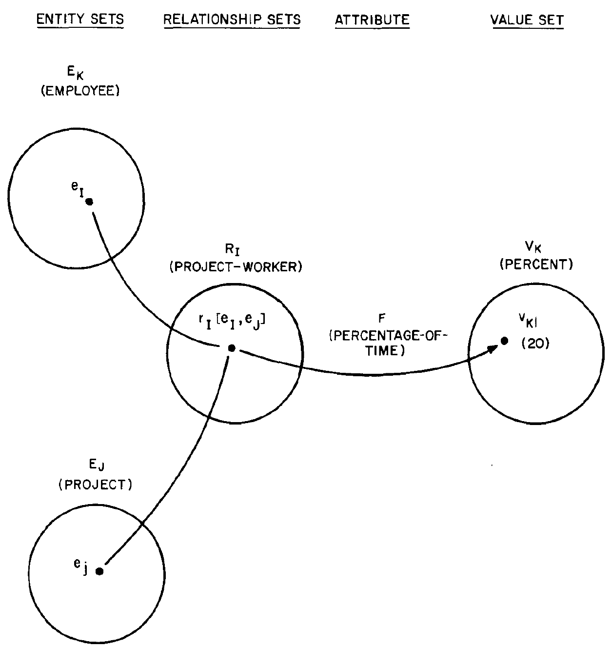
Relationship Attributes
The attribute PERCENTAGE-OF-TIME, which is the portion of time a particular employee is committed to a particular project, is an attribute defined on the relationship set PROJECT-WORKER.
It is neither an attribute of EMPLOYEE nor an attribute of PROJECT, since its meaning depends on both the employee and project involved.

Slide 14
Conceptual Information Structure
We are now concerned with how to organize the information associated with entities and relationships.
The method proposed in this paper is to separate the information about entities from the information about relationships.

Slide 15
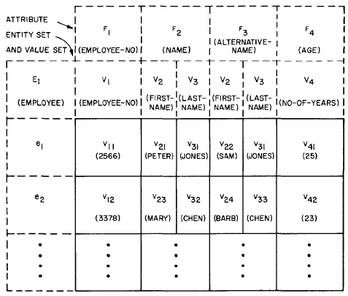
Example
Entity Set, Attributes and Value Sets

Slide 16
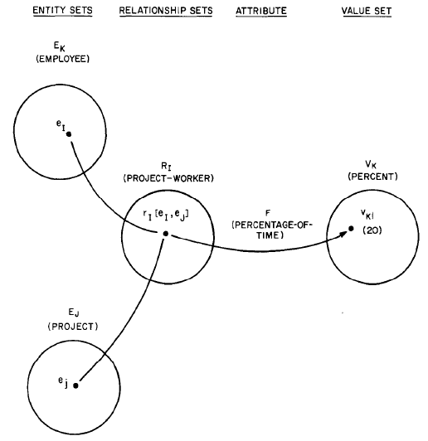
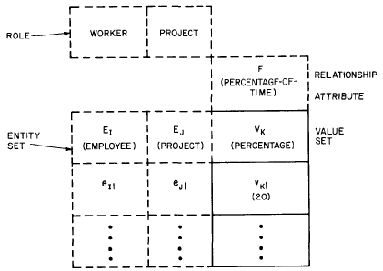
Relationship Set

Slide 17
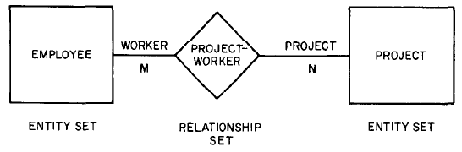
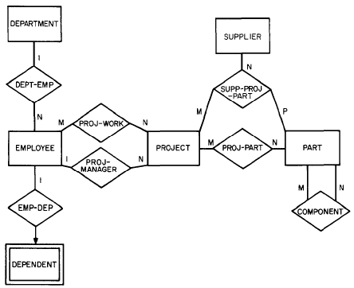
Entity Relationship Diagram

Slide 18
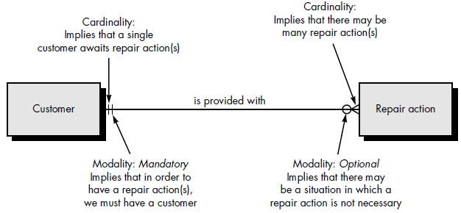
Cardinality and Modality [2]
Cardinality is the specification of the number of occurrences of one [object] that can be related to the number of occurrences of another [object].
Cardinality defines “the maximum number of objects that can participate in a relationship”.
The modality of a relationship is 0 if there is no explicit need for the relationship to occur or the relationship is optional. The modality is 1 if an occurrence of the relationship is mandatory.

Slide 19
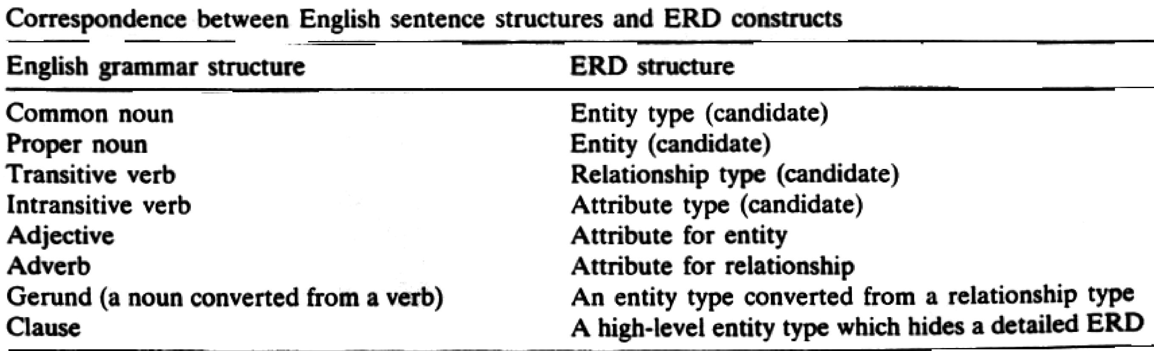
How to Create an ERD Diagram? [3]

Slide 20
ERD vs. Relational Model
Edgar E Codd (1990). The Relational Model for Database Management Version 2.
An Entity Relationship Diagram defines the relationship between entities and their attributes. An ERD contains many-to-many relationships and but does not include foreign keys. The foreign keys are implied. In an ERD, we are simply visualizing the entities, their attributes, and the relation between them. We do not care about where foreign keys go or how to implement that many-to-many relationship. (But we do underline primary keys!). An ERD describes mapping cardinalities.
In a Relational Model we are referring to an implementation of our model. At this point we should be clear about the formats of our attributes, the foreign keys we use, and the linking tables we might need to stitch entities together. A relational model does not describe mapping cardinalities. A relational model is basically a model of a possible database implementation.
In short, an ERD is an abstract concept of our database, it speaks in entities and attributes, an entity model. A relational model defines formats and relations in a way a database could understand, a data model.

Slide 21


Slide 22
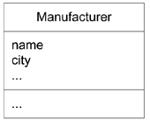
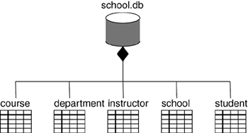
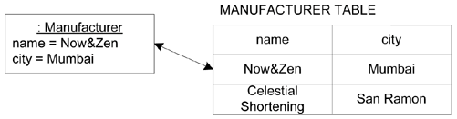
Mapping Classes to Tables [4, 5]
Artifacts can have attributes, so a common idiom when modeling physical databases is to use these attributes to specify the columns of each table.
Similarly, artifacts can have operations, and these can be used to denote stored procedures.
For simple CRUD (create, read, update, delete) operations, implement them with standard SQL or ODBC calls.
For more-complex behavior (such as business rules), map them to triggers or stored procedures.

Slide 23
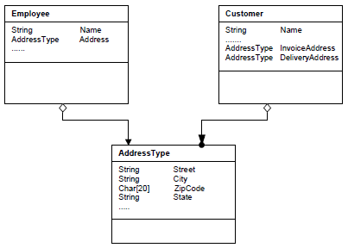
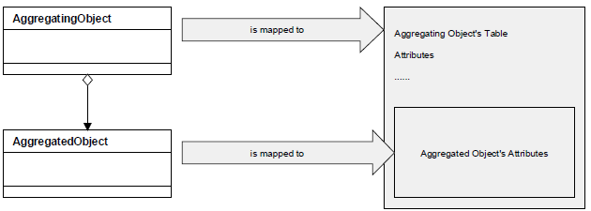
Single Table Aggregation [6]

Slide 24
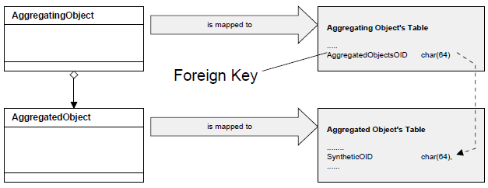
Foreign Key Aggregation

Slide 25
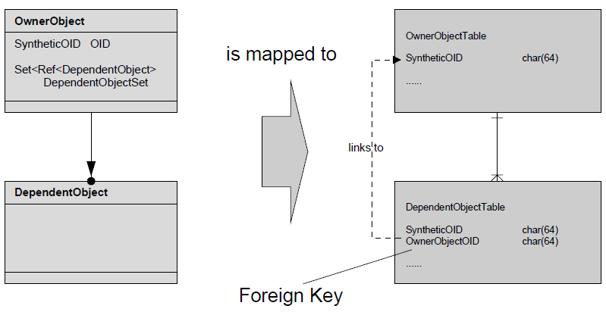
Foreign Key Association

Slide 26
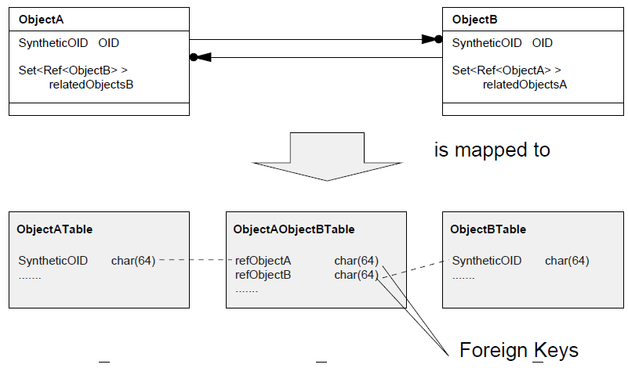
Association Table

Slide 27
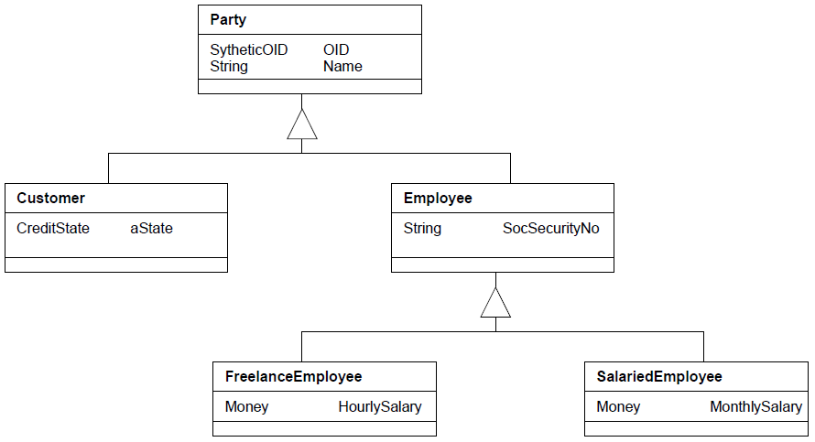
Mapping Inheritance

Slide 28
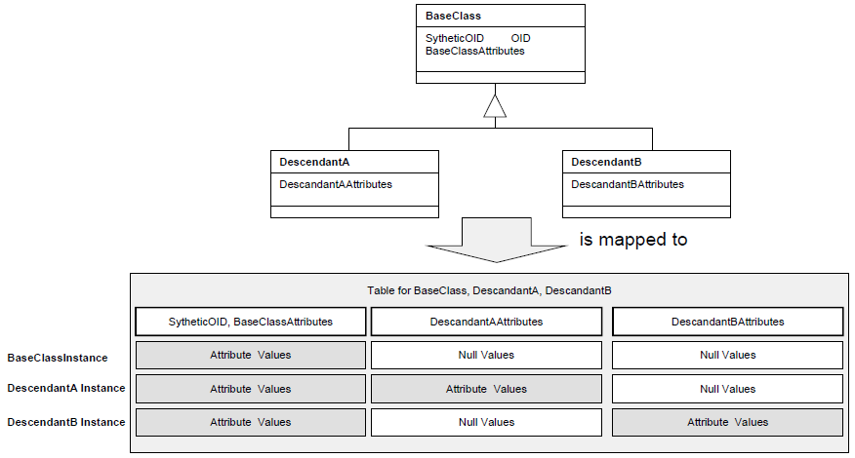
One Inheritance Tree One Table

Slide 29
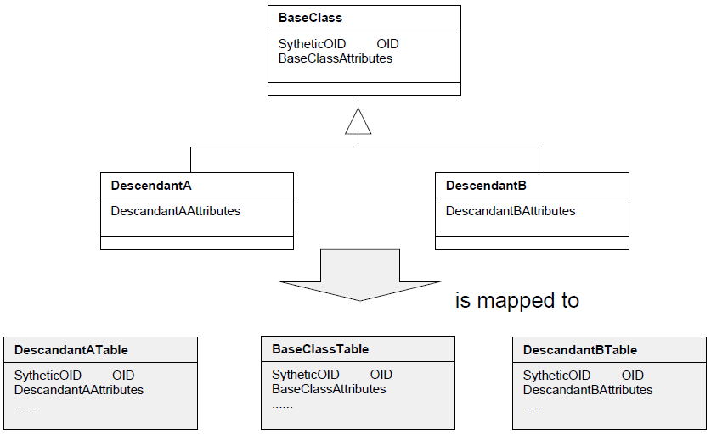
One Class One Table

Slide 30
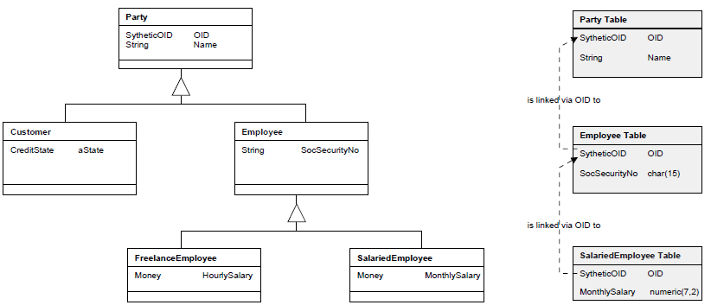
One Class One Table Example

Slide 31
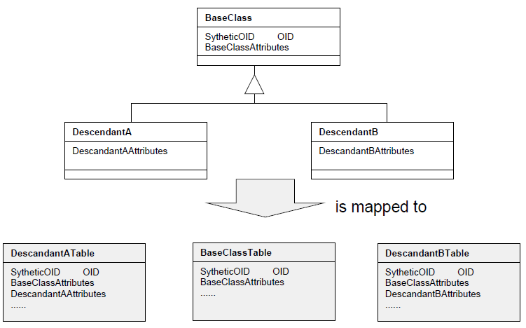
One Inheritance Path One Table

Slide 32
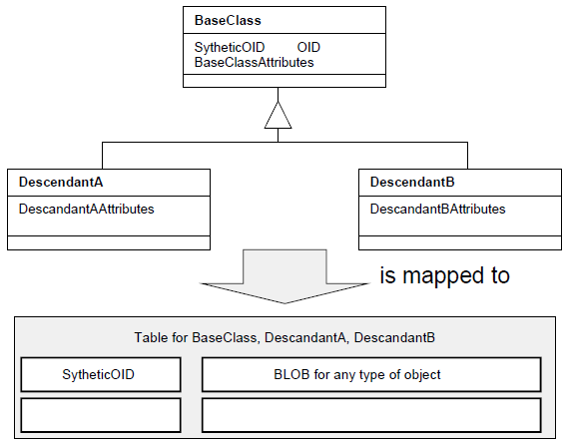
Objects in BLOBs

Slide 34
Entity—Attribute—Value (EAV) Tables Motivation [7]
A clinical patient record needs to store several thousand possible facts for patients across all specialties.
For any given patient, however, the number of actual findings may not exceed a few dozen.
A conventional (“orthodox”) database table design (one fact per column) is unsuitable for such data, because of database vendor limitations on the number of columns per table and the need to continually add new tables or columns whenever new facts need incorporation.
Example:
(〈patient XYZ〉, 1/5/98 12:00 AM, 12.5 gm/dl, 4.9 Meq/L, 80 IU …)
(〈patient XYZ〉, 1/5/98 12:00 AM, “Hemoglobin,” 12.5 gm/dl)
(〈patient XYZ〉, 1/5/98 12:00 AM, “Potassium,” 4.9 Meq/L)

Slide 35
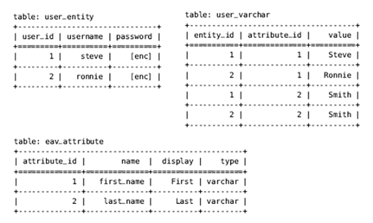
Entity Attribute Value Model
https://blog.magestore.com/entity-attribute-value-in-magento/
Developers can add attributes to any entity (product, category, customer, order etc) without modifying the core database structure.

Slide 36
Ad Hoc Query
SELECT Patient_ID, 〈attributes to be displayed〉
FROM Data_table
WHERE 〈patient selection criteria based on attributes〉
SELECT user_id, attribute_id, display, value
FROM user_varchar
INNER JOIN user_entity
ON user_entity. user_id = user_varchar.entity_id
INNER JOIN eav_attribute
ON eav_attribute.attribute_id = user_varchar.attribute_id
WHERE entity_id = 100

Slide 37
EAV Model Drawbacks
A major downside of EAV is its speed.
With entity data being so fragmented, creating a whole entity record requires a lot of expensive table joins.

Slide 38

Thank You & See You Again

